Slide 1
Demographics and food
Group I
Maria Jadoon
Emily Kuhns
Martel Mann
Coel Locandro

Slide 2
Summary
Core message/hypothesis: Demographics effect what Americans eat, how much they spend and how they review restaurants
Describe the questions you asked, and _why_ you asked them
Insert your question:
1. Does income per capita affect the popularity of $$$ and $ restaurants?
2. Does poverty rate affect the popularity of $$$ and $ restaurants?
3. Does income per capita affect the average rating of restaurants?
4. Does the diversity of the population in a State affect their taste in food?
Describe whether you were able to answer these questions to your satisfaction, and briefly summarize your findings

Slide 3
Questions & Data
Questions
How does demographics affect food preference?
Does economic status affect food preference?
Does race affect food preference?
Data
Demographic information was obtained from Census data that was found on Kaggle.com. This dataset is categorized by census tract and contains demographic info related to location, gender, race, and economic status.
Yelp! data was collected using the Yelp API. Information collected includes location, rating, number of reviews, and cuisine type.

Slide 4
Questions & Data
Data cleaning

Slide 5
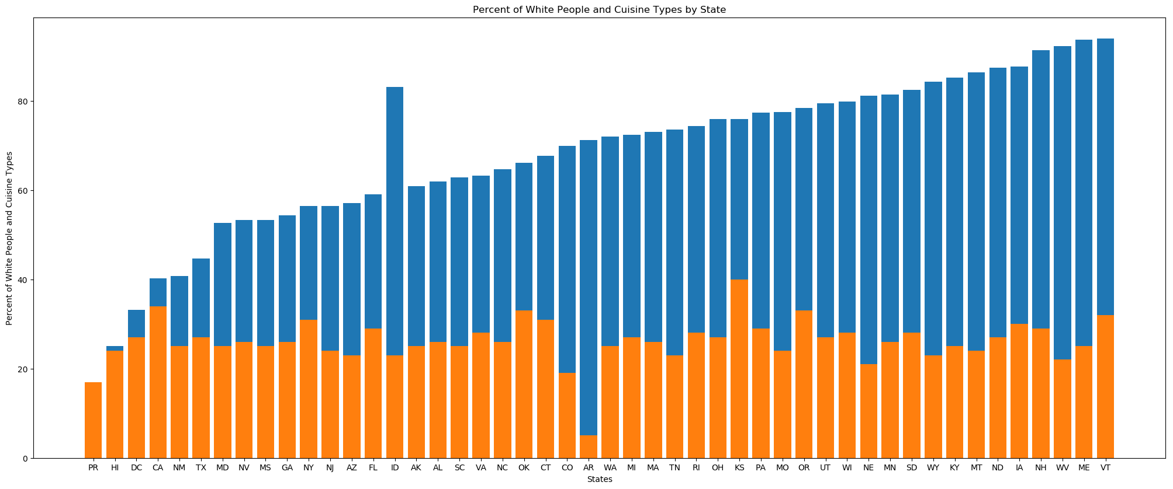
Does the diversity of the population in a State affect their taste in food?
Discuss the steps you took to analyze the data and answer each question you asked in your proposal
Present and discuss interesting figures developed during analysis, ideally with the help of Jupyter Notebook
Discuss your findings. Did you find what you expected to find? If not, why not? What inferences or general conclusions can you draw from your analysis?

Slide 6
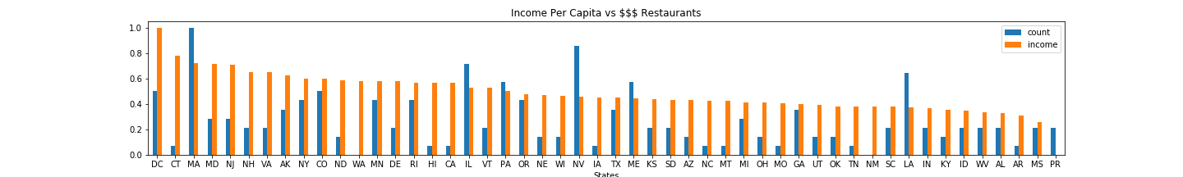
Does income per capita affect the popularity of $$$ restaurants?
California : Few $$$ restaurants compared to per capita income
Nevada : More $$$ restaurants compared to per capita income
Washington and Puerto Rico : Problem in data collection

Slide 7

Does income per capita affect the popularity of $ restaurants?
State | $$$ | $
MA | 15 | 3
CA | 2 | 10

Slide 8
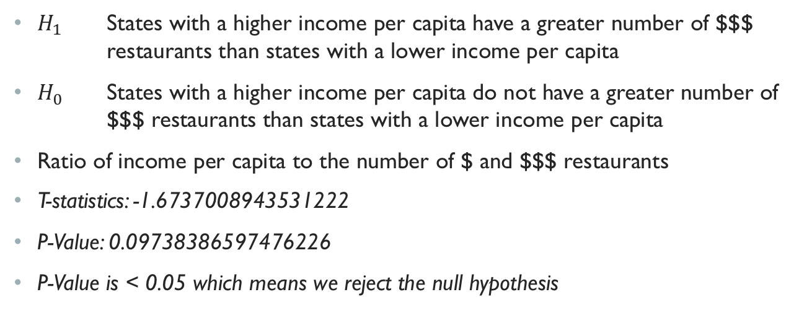
Income per capital does impact the number of $$$ Restaurants
$H_{1}$ States with a higher income per capita have a greater number of $$$ restaurants than states with a lower income per capita
$H_{0}$ States with a higher income per capita do not have a greater number of $$$ restaurants than states with a lower income per capita
Ratio of income per capita to the number of $ and $$$ restaurants
T-statistics: -1.6737008943531222
P-Value: 0.09738386597476226
P-Value is < 0.05 which means we reject the null hypothesis

Slide 9
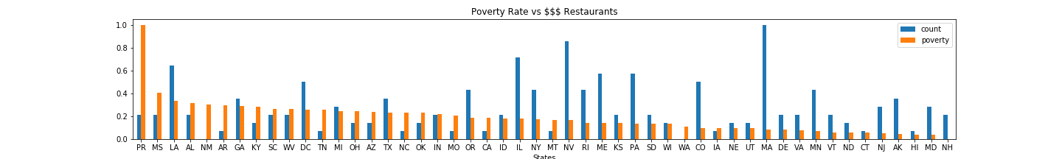
Does poverty rate affect the popularity of $$$ restaurants?
The count of $$$ restaurants appears to increase as the poverty rate decreases.

Slide 10
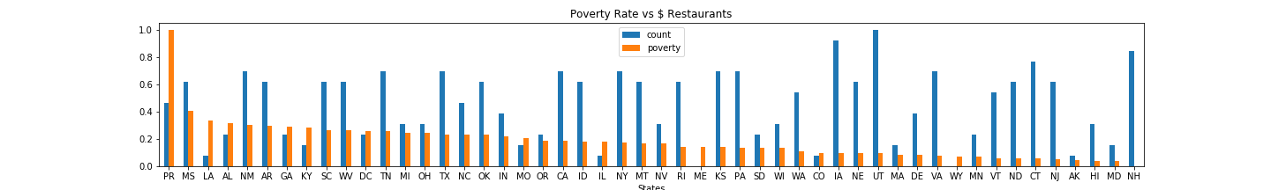
Does poverty rate affect the popularity of $ restaurants?
The count of $ restaurants doesn’t appear to vary with changes in poverty rate.

Slide 11
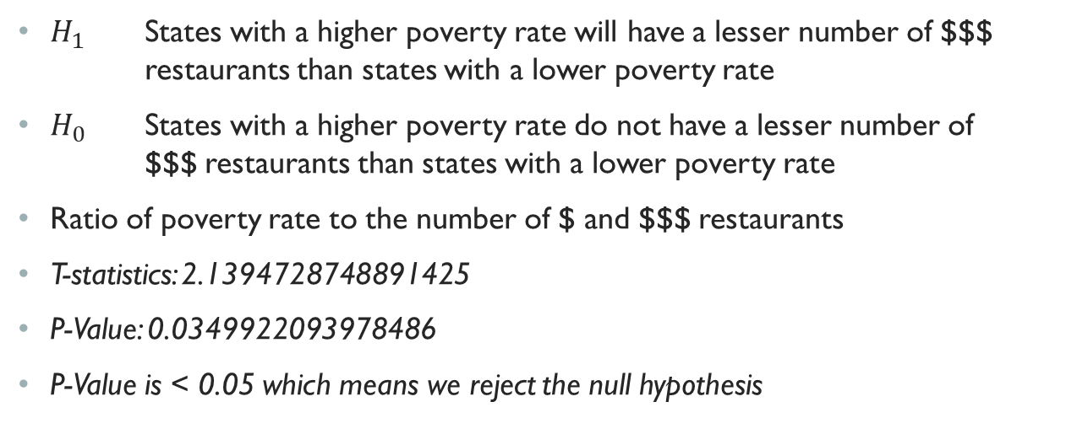
Poverty Rate does impact the number of $$$ Restaurants
$H_{1}$ States with a higher poverty rate will have a lesser number of $$$ restaurants than states with a lower poverty rate
$H_{0}$ States with a higher poverty rate do not have a lesser number of $$$ restaurants than states with a lower poverty rate
Ratio of poverty rate to the number of $ and $$$ restaurants
T-statistics: 2.1394728748891425
P-Value: 0.0349922093978486
P-Value is < 0.05 which means we reject the null hypothesis

Slide 12
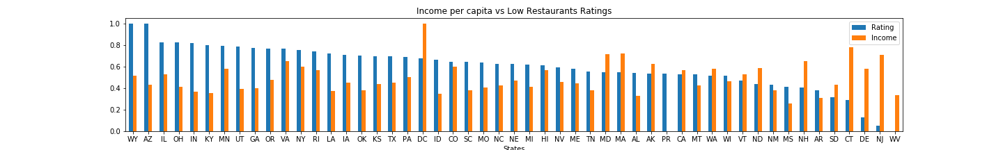
Income per capital does impact the RATINGS OF Restaurants
DE, NJ: Few “low rating” restaurant reviews compared to per capita income
DC: Income higher than other states compared to per capita income
Florida: Problem in data collection

Slide 13
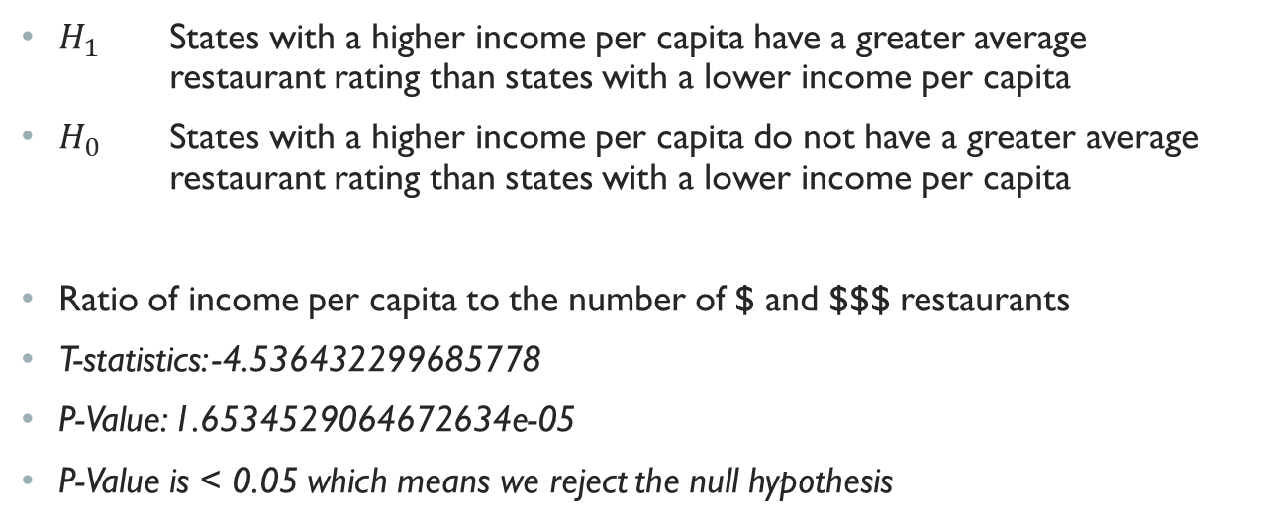
Income per capital does impact the RATINGS OF Restaurants
$H_{1}$ States with a higher income per capita have a greater average restaurant rating than states with a lower income per capita
$H_{0}$ States with a higher income per capita do not have a greater average restaurant rating than states with a lower income per capita
Ratio of income per capita to the number of $ and $$$ restaurants
T-statistics: -4.536432299685778
P-Value: 1.6534529064672634e-05
P-Value is < 0.05 which means we reject the null hypothesis

Slide 14
Post Mortem
Data collection issues
Limitations of Census API
Limitations of Yelp API
Normalization of data

